Slide 1
Welcome to Starry Starry Night! February 8, 2024
PTA General Meeting
6:00 PM

Slide 2
Welcome Message from Dr. Connery

Slide 3
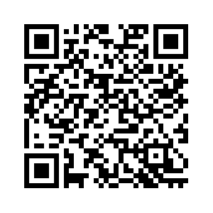
Educational Effectiveness Surveys
EES Family Surveys: A Parent Square Message was sent from the county to families via Parent Square at 6:30 AM on Thursday, February 1, and included a link to the Family Survey.
Below is that link or QR code if you should need it: https://gcpsk12ga.qualtrics.com/jfe/form/SV_d3TiP2tbbnwRo58
For more information visit: https://www.gcpsk12.org/families/surveys

Slide 4
Gentle reminders for the Month of February
FEBRUARY
February 5 - 9 - Star Wars (Coin Wars) February 8 - Starry, Starry Night, PTA Reflections from 6-7 PM
February 9 - Severe Weather Drill at 1:30 PM
February 13 - All Pro Dads at 7 AM
February 15 - 19 - Late Winter Break/ Schools Closed
February 22 - Spirit Night with PMS at Knuckies from 5-7 PM
February 22 - Starburst Shirt Order Deadline
February 27 - Talent Show (4th & 5th Grade) Dress Rehearsal February 29 -Talent Show (4th & 5th Grade)

Slide 5
Announcements Save-the-Date
March 6th & 7th Parent/Teacher Conferences
Conference links will go live on Simpson's website on Tuesday, February 20th at 9:00AM.
April 1st--5th Spring Break

Slide 6
Emergency Drills
Monthly Fire Drills
February, Severe Weather Drill Month (2/9/24)
Intruder Alert Drill will be held in March

Slide 7
Simpson Elementary School Budget

Slide 8
Simpson Elementary School
Parent Teacher Association
Mission: “ To make every child's potential a reality by engaging and empowering families and communities to advocate for all children.”

Slide 9
YOUR PTA DOLLARS AT WORK
www.SimpsonESPTA.org
Number of PTA members: 400
Amount given to staff/teachers to-date: $10,825.87
Amount donated to Care Team Families: over $2,000
Event Highlights: Author Visits, Fall Festival, Mother-Son Night, Sweetheart Dance, Care Team Support, Monthly Staff Appreciation, Monthly Spirit Night Events
Visit www.simpsonespta.org for more information

Slide 10
UPCOMING PTA EVENTS
February 5 – 9, 2024 – Star Wars Coin Wars Fundraiser
February 13, 2024 – All Pro Dads 7am
February 14, 2024 – All Staff Appreciation
February 15-19 Mid-Winter Break
February 22, 2024 – Starburst Shirt Orders LAST CHANCE!
& SPIRIT NIGHT Knuckies 5-7 with Pinckneyville Middle School
February 29, 2024 – Simpson’s Got Talent
NEXT GENERAL PTA MEETING
The next general PTA meeting will be on
Thursday, April 25, 2024 at 6:00 pm
before the Kindergarten Sings event.

Slide 11
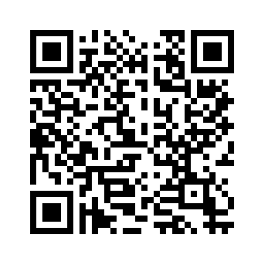
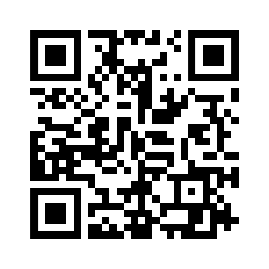
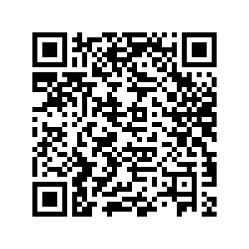
Simpson Elementary School PTA General Membership Meeting
Please scan the QRs below to Volunteer
Your Time or Resources to our PTA’s efforts.
Thank You for your Year Round Support!
Staff Appreciation
Starburst Shirts
Talent Show Help
Visit www.simpsonespta.org for more information

Slide 12
Simpson Elementary School PTA General Membership Meeting
Nominating Committee for the
2024-2025 PTA Board & Committees:
Jordan Mallory
Jillian Friedensohn
Julie Miller
Kendra Leblang
Alternate: Kelsey Dykes
Visit www.simpsonespta.org for more information

Slide 13
Simpson Elementary School PTA
General Membership Meeting
Open PTA Executive Board Positions
2024-2025 School Year
Co-President
VP of Finance
VP of Communications and Publications
VP of Staff and Student Services
VP of Family and Community Outreach
Visit www.simpsonespta.org for more information

Slide 14
I am Hopeful Because…
CONGRATS TO ALL SIMPSON
2023-2024 REFLECTIONS WINNERS!!!
We received a total of 140 entries this year
1st and 2nd place winners and ALL Special Artists’ entries advance to Gwinnett County Area II Council Competition

Slide 15
Special THANK YOU to our judges!
Visual Arts
Ms. Laura Elizabeth Martin, Fine Arts Teacher, Paul Duke STEM High School
Photography
Jesse Wade, Founder/Owner/Operator of JAWs Photography, JAWsPhotography.com
Dance Choreography
Ms. Leah Rogowski, North Atlanta Dance Theatre Company Member
Film Production
Ms. Lydia Bolen, Communications-AVTF Teacher, Pinckneyville Middle School
Music Composition
Mr. Gary Garvin, Band Director, Paul Duke STEM High School
Literature
Dr. Esther Armistead, Language Arts Teacher, Paul Duke STEM High School
Mr. Richard Armistead, Language Arts Teacher, Paul Duke STEM High School

Slide 16
And the WINNERS for Visual Arts are…
Kindergarten
1st: Lane R.
2nd: Jillian Z.
3rd: Zoe M.
1st Grade
1st: Lydia P.
2nd Grade
1st: Aubrey L.
2nd: Amelia G.
3rd: Austin G.
3rd Grade
1st: Caroline G.
2nd: Cassidy O.
3rd: Rory O.
4th Grade
1st: Pierce F.
2nd: Lillian D.
3rd: Yinuo L.
5th Grade
1st: Daniel L.
2nd: Callie B.
3rd (tie): Morgan B.
Arden W.

Slide 17
And the WINNERS for Photography are…
Kindergarten
1st: Nick O.
1st Grade
1st: Lydia P.
2nd Grade
1st: Lia L.
2nd: London F.
3rd: Amelia G.
3rd Grade
1st: Brianna T.
2nd: Adam O.
3rd: Kendall R.
4th Grade
1st: Sydney P.
2nd: Pierce F.
3rd: Wesley P.
5th Grade
1st: Mia M.
2nd: Daniel L.
3rd: Arden W.

Slide 18
And the WINNERS for Photography are…
Kindergarten
1st: Nick O.
1st Grade
1st: Lydia P.
2nd Grade
1st: Lia L.
2nd: London F.
3rd: Amelia G.
3rd Grade
1st: Brianna T.
2nd: Adam O.
3rd: Kendall R.
4th Grade
1st: Sydney P.
2nd: Pierce F.
3rd: Wesley P.
5th Grade
1st: Mia M.
2nd: Daniel L.
3rd: Arden W.

Slide 19
And the WINNERS for Dance Choreography are…
Kindergarten
1st: Everly F.
1st Grade
1st: Phoebe T.
2nd: Lydia P.
2nd Grade
1st: Riley M.
2nd: London F.
3rd Grade
1st: Isla W.
2nd: Mark D.
4th Grade
1st (tie): Eleanor W.
Emery L.
5th Grade
1st: Mia M.

Slide 20
And the WINNERS for Dance Choreography are…
Kindergarten
1st: Everly F.
1st Grade
1st: Phoebe T.
2nd: Lydia P.
2nd Grade
1st: Riley M.
2nd: London F.
3rd Grade
1st: Isla W.
2nd: Mark D.
4th Grade
1st (tie): Eleanor W.
Emery L.
5th Grade
1st: Mia M.

Slide 21
And the WINNERS for Film / Video Production are…
Kindergarten
1st: Gavin H.
2nd: Nick O.
2nd Grade
1st: Lia L.
3rd Grade
1st: Adam O.
4th Grade
1st: Harper D.
2nd: Maggie S.
3rd (tie): Miller T.
Jack V.
5th Grade
1st: Cate O.
2nd: Arden W.
3rd: Mia M.

Slide 22
And the WINNERS for Film / Video Production are…
Kindergarten
1st: Gavin H.
2nd: Nick O.
2nd Grade
1st: Lia L.
3rd Grade
1st: Adam O.
4th Grade
1st: Harper D.
2nd: Maggie S.
3rd (tie): Miller T.
Jack V.
5th Grade
1st: Cate O.
2nd: Arden W.
3rd: Mia M.

Slide 23
And the WINNERS for Music Composition are…
1st Grade
1st: Adeline P.
2nd: Nathaniel G.
2nd Grade
1st: Amelia P.
2nd: Leia N.
3rd: Thomas G.
3rd Grade
1st: Caroline G.
2nd: Isla W.
3rd: Garrett V.
4th Grade
1st: Hannah V.
2nd: Evan M.
3rd: Yinuo L.
5th Grade
1st: Arden W.
2nd: Logan W.
3rd: Kaitlyn G.

Slide 24
And the WINNERS for Music Composition are…
1st Grade
1st: Adeline P.
2nd: Nathaniel G.
2nd Grade
1st: Amelia P.
2nd: Leia N.
3rd: Thomas G.
3rd Grade
1st: Caroline G.
2nd: Isla W.
3rd: Garrett V.
4th Grade
1st: Hannah V.
2nd: Evan M.
3rd: Yinuo L.
5th Grade
1st: Arden W.
2nd: Logan W.
3rd: Kaitlyn G.

Slide 25
And the WINNERS for Literature are…
Kindergarten
1st: Jillian Z.
1st Grade
1st: Juliet P.
2nd Grade
1st: Lydia H.
3rd Grade
1st: Lilly Mae D.
2nd: James Z.
3rd: Ellie S.
4th Grade
1st: Ephraim H.
2nd: Sydney P.
3rd: Yinuo L.
5th Grade
1st: Mia M.
2nd: Cate O.
3rd: Arden W.

Slide 26
And the WINNERS for Literature are…
Kindergarten
1st: Jillian Z.
1st Grade
1st: Juliet P.
2nd Grade
1st: Lydia H.
3rd Grade
1st: Lilly Mae D.
2nd: James Z.
3rd: Ellie S.
4th Grade
1st: Ephraim H.
2nd: Sydney P.
3rd: Yinuo L.
5th Grade
1st: Mia M.
2nd: Cate O.
3rd: Arden W.

Slide 27
And the WINNERS for Visual Arts 3D are…
Kindergarten
1st: Jillian Z.
2nd: Nick O.
1st Grade
1st: Abigail G.
2nd: Lydia P.
3rd Grade
1st: Acadia T.
2nd: James Z.
3rd: Anya S.
4th Grade
1st: Noah A.
2nd: Wesley P.
5th Grade
1st: Daniel L.
2nd: Arden W.
3rd: Cate O.

Slide 28
And the Special Artist WINNERS for Visual Arts are…
Emmy M.
Donovan S.
Eva B.
Cali F.
Alexa C.
Emory G.

Slide 29
And the Special Artist WINNERS for Visual Arts are…
Emmy M.
Donovan S.
Eva B.
Cali F.
Alexa C.
Emory G.

